Slide 1
How To Make Calculator
Presented By Er. Sudan Prajapati

Slide 2
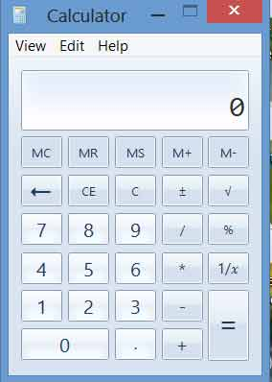
Introduction

Slide 3
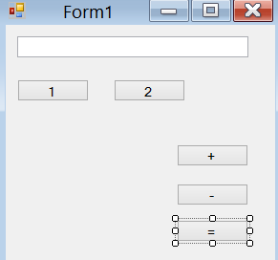
Steps
Step1:Create a new win form application and design the form change text of the form as in figure below:

Slide 4
Steps
Step2:Change the name of the button1 to btn_click and double click button
Step 3:change the textbox1.text Name to textResult.
Step 4:Initialize the varaible after public partial class Form1 : Form
Double calcResult;
string opratorsPerformed="";
bool isOperationPerformed=false;

Slide 5
Steps
Step 5: Add the code
private void btnClick_Click(object sender, EventArgs e) {
if (isOperationPerformed) {
textBoxResults.Clear();
}
Button btn=(Button)sender;
isOperationPerformed = false;
textBoxResults.Text = textBoxResults.Text + btn.Text;
}

Slide 6
Steps
Step 6: In buttons like 1 2 3 ..9 set the properties click value to the btnClick_Click.
Step 7: In button + change the name to operatorClick and double click the button add code.
private void operatorClick_Click(object sender, EventArgs e)
{
Button btn = (Button)sender;
opratorsPerformed = btn.Text;
calcResult = Double.Parse(textBoxResults.Text);
isOperationPerformed=true;
}

Slide 7
Steps
Step 8: In buttons like + - / set the properties click value to the operatorClick.
Step 7: In button = double click and add code
private void button5_Click(object sender, EventArgs e) {
switch (opratorsPerformed) {
case "+":
textBoxResults.Text = (calcResult + Double.Parse(textBoxResults.Text)).ToString();
break;
case "-":
textBoxResults.Text = (calcResult - Double.Parse(textBoxResults.Text)).ToString();
break;
default:
break; }

